Slide 1
Release-as-code Design sprint
November 2016

Slide 2
Goal
Make XL Release developer-friendly while keeping it friendly for non-developers.

Slide 3
What does that mean?
Allow templates, releases and other configuration objects to be defined as code.
Allow for dynamic definition of those objects based.
Allow that code to be stored in SCM.
Provide a developer-friendly language.
Provide non-developer insight into what’s happening.

Slide 4
Choices/decisions
Language:
No JSON – too cumbersome.
No YAML – not dynamic enough.
Still to decide:
Python script or Groovy DSL.
How to invoke:
CLI.
Script task.
SCM trigger.

Slide 5
Scenarios
Automatically setup multiple templates for maintenance branches, from the command line.
Automatically setup new teams, from a script task.
Run a dynamically generated release, from a trigger.

Slide 6
CLI in XL Release

Slide 7
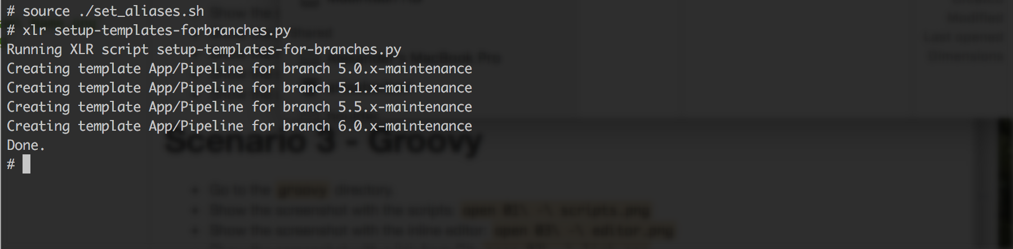
Executing from CLI

Slide 8
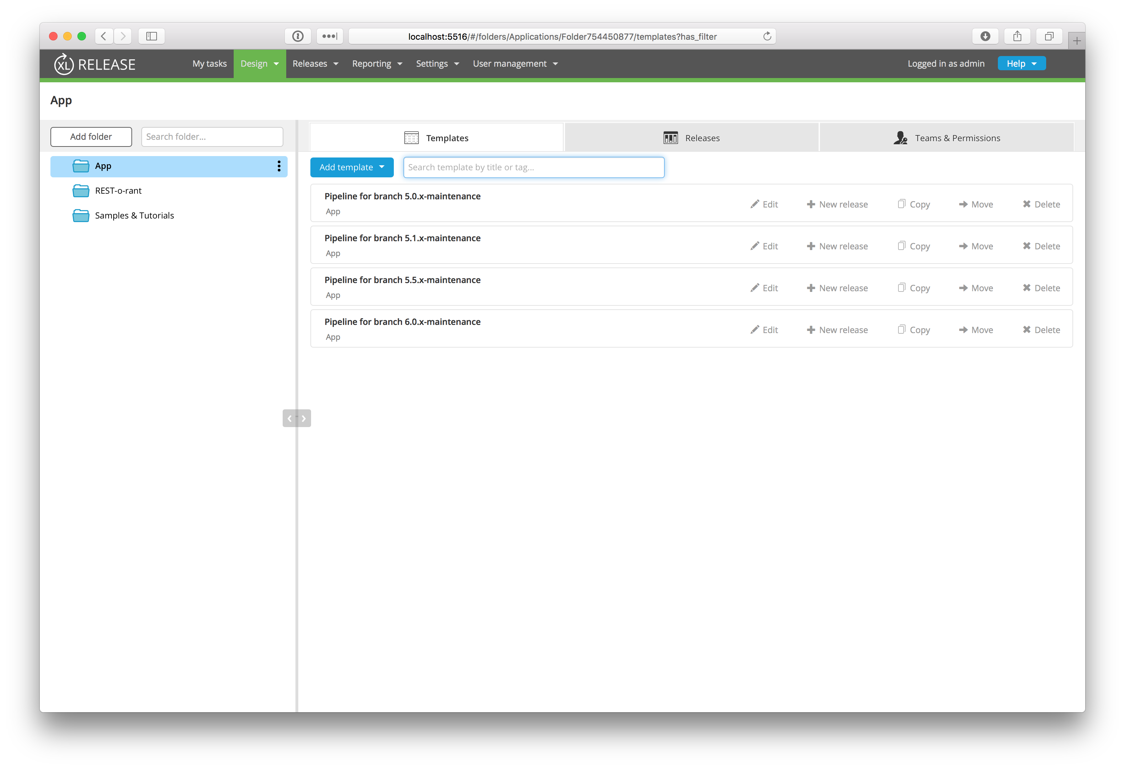
Results

Slide 9
Seeding Template From A Release

Slide 10
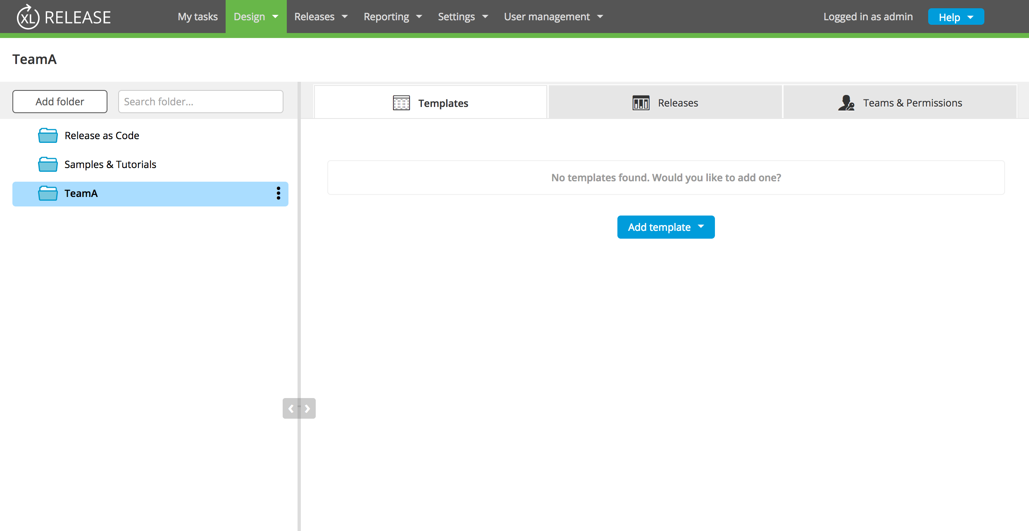
Team Folder

Slide 11
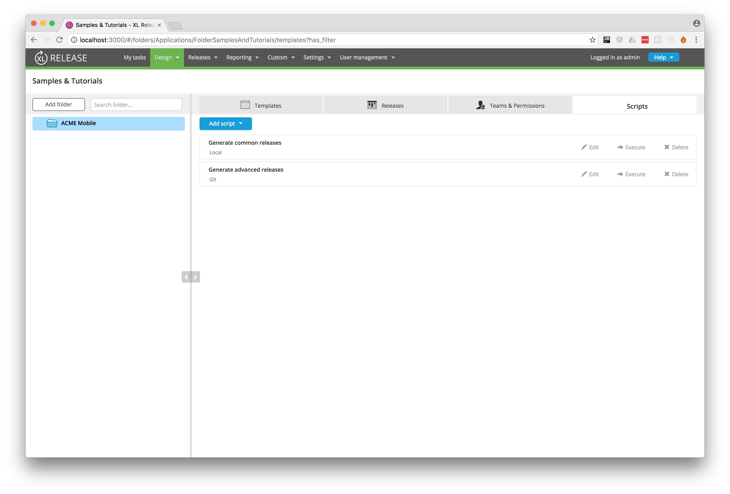
Adding Script Folder

Slide 12
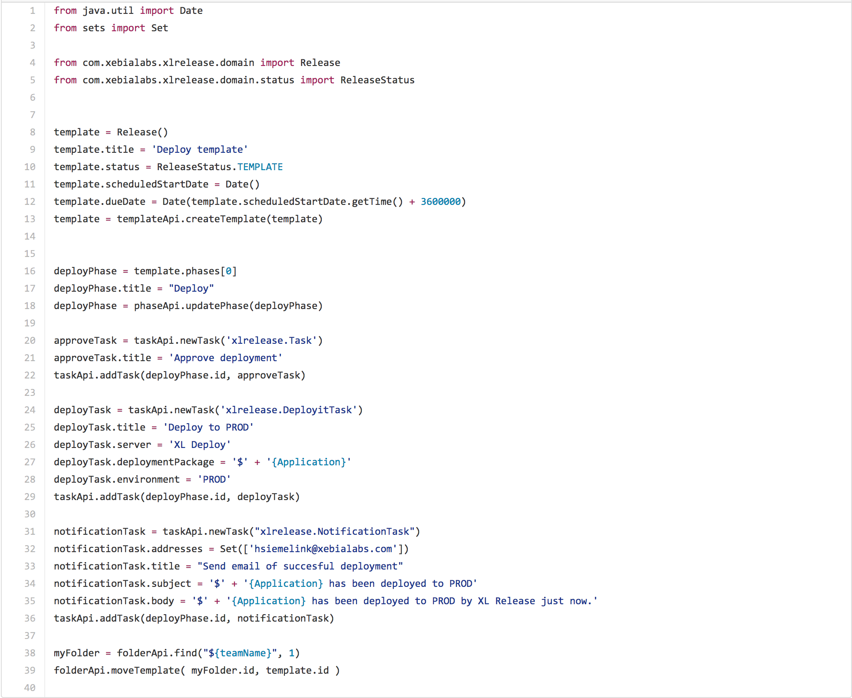
Script

Slide 13
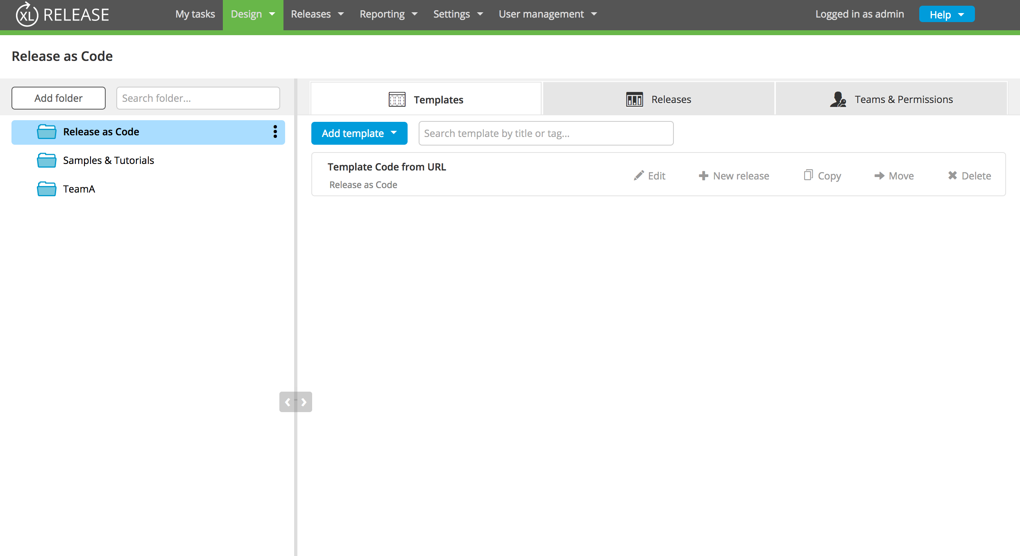
Release as Code Folder

Slide 14
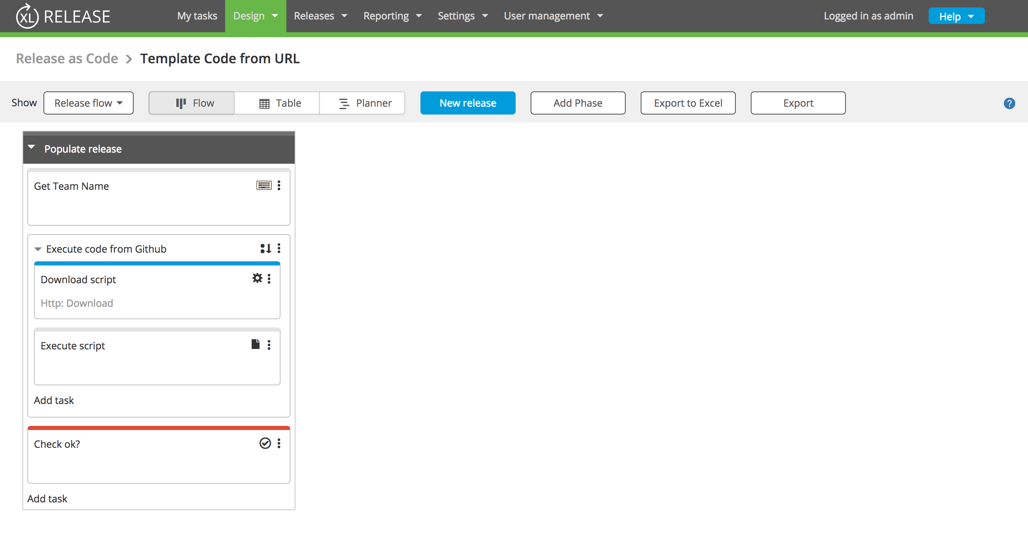
Release Template

Slide 15
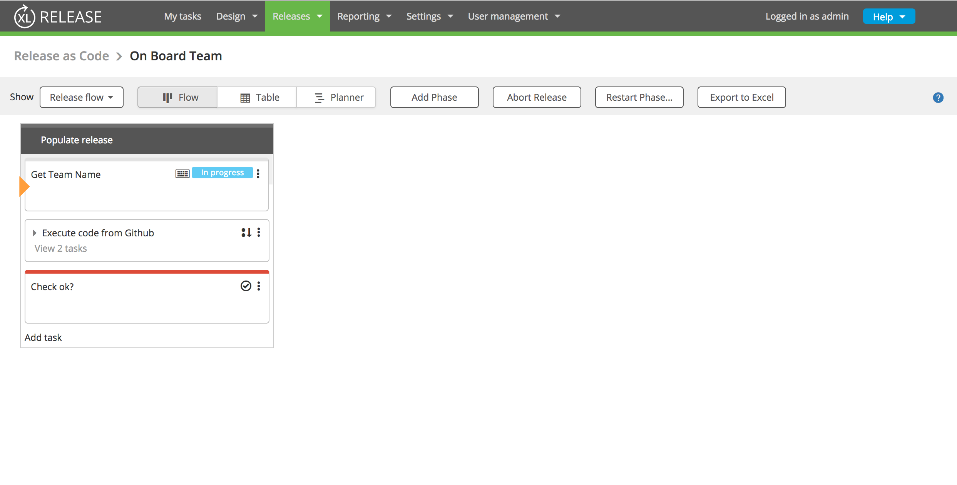
Release Start

Slide 16
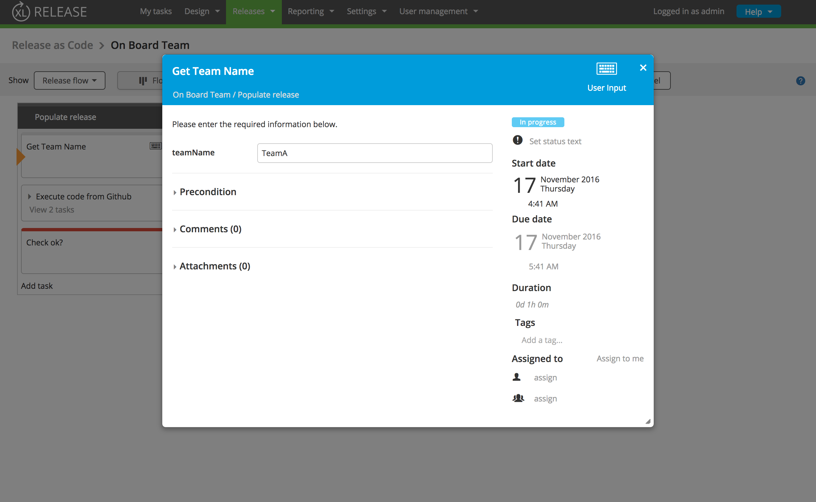
Set Release Team Name

Slide 17
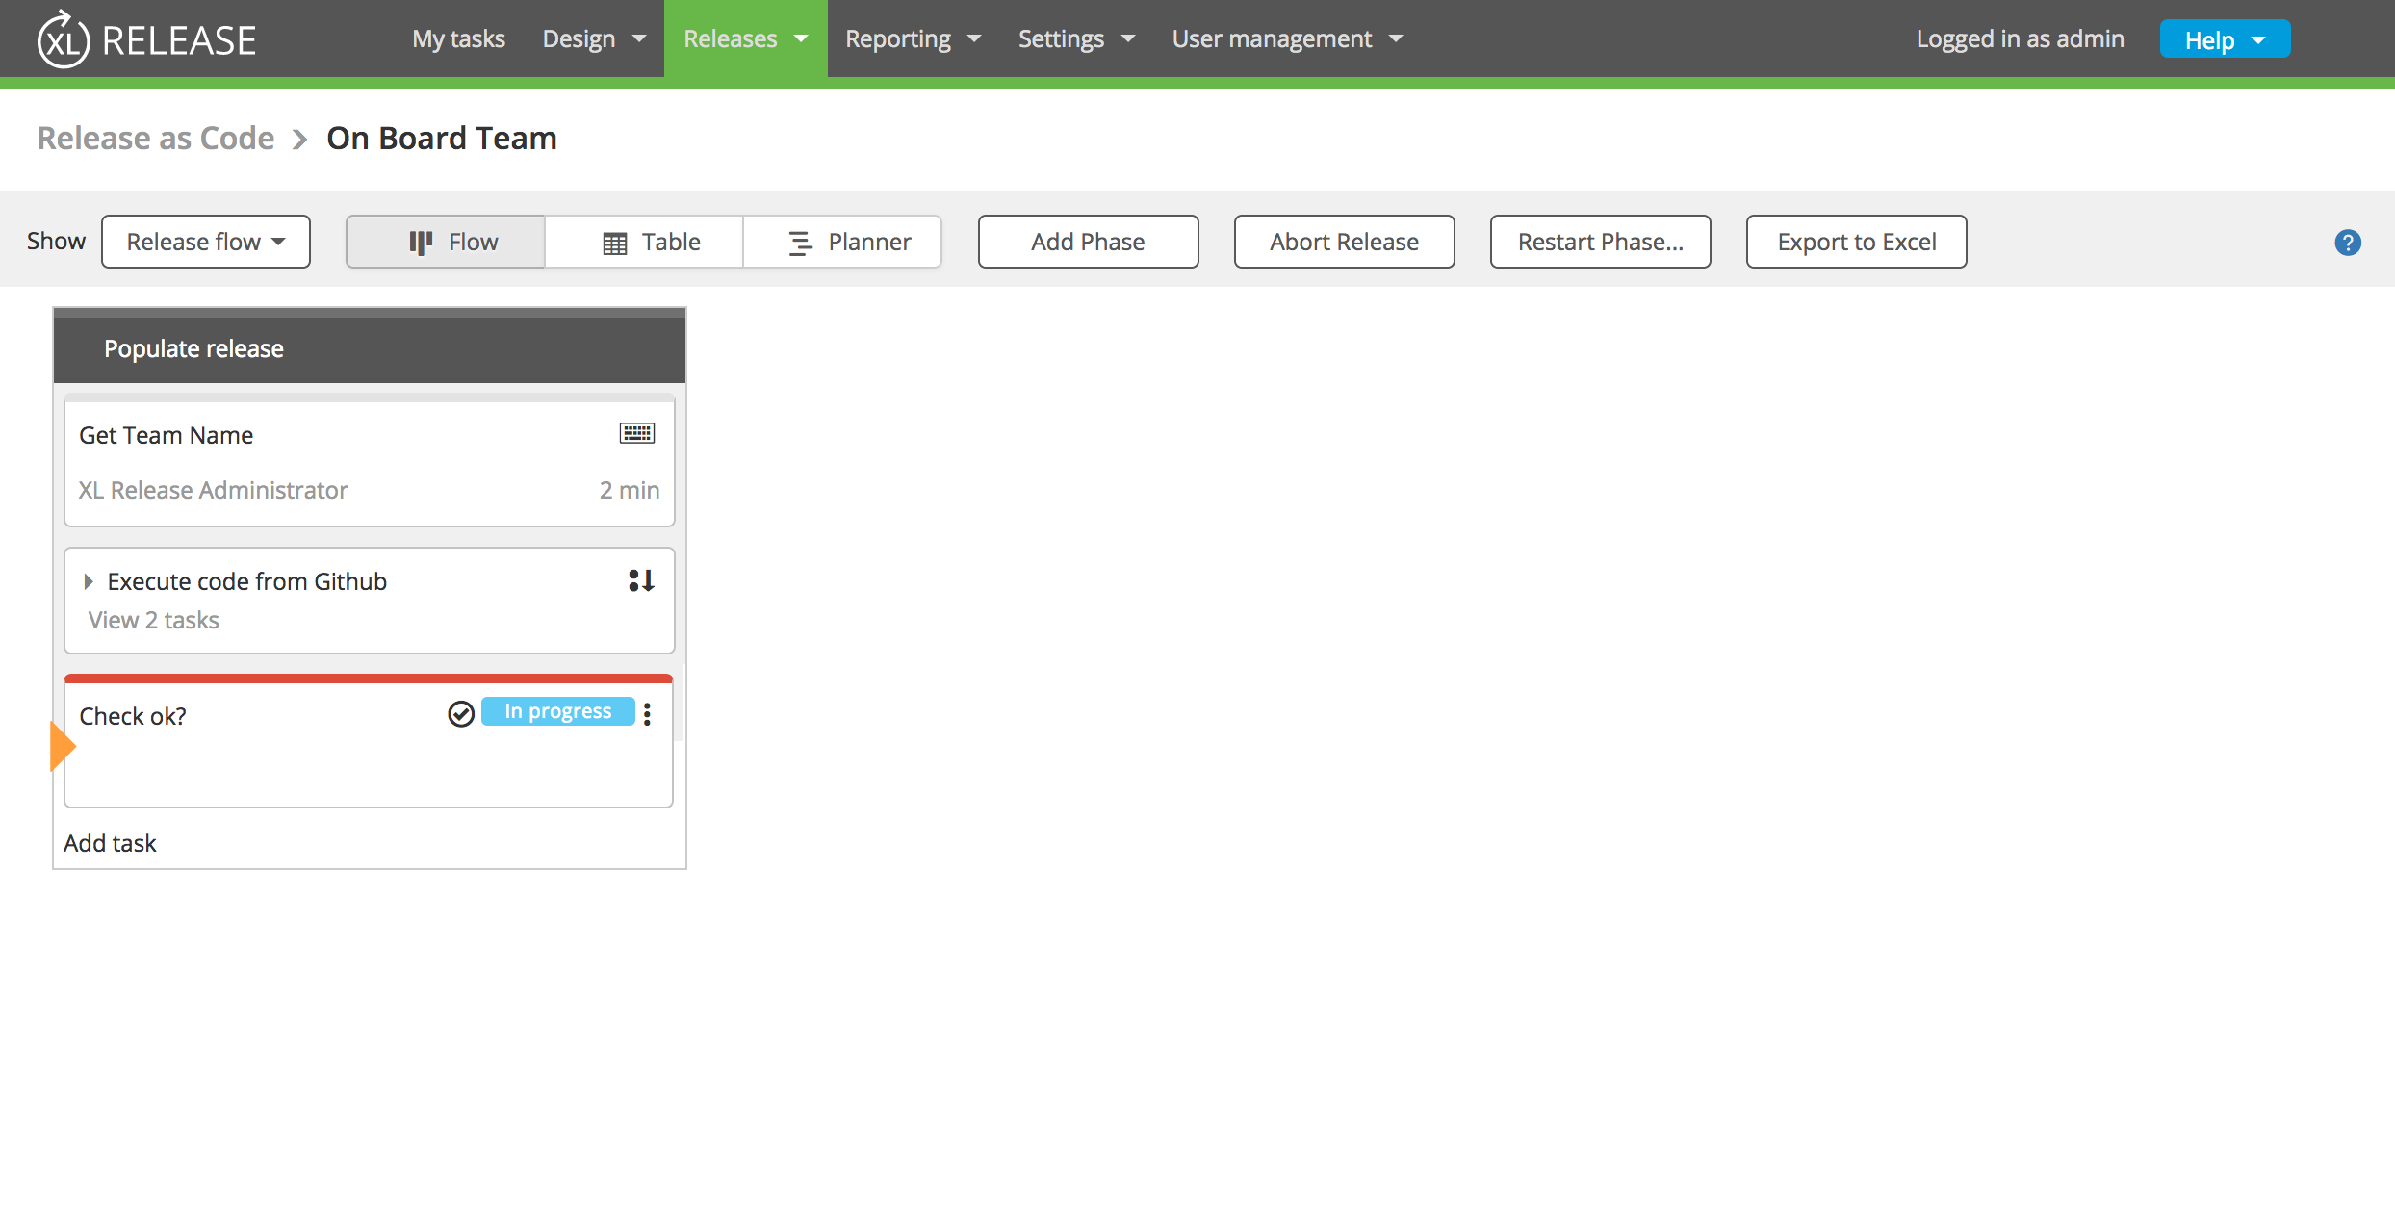
Release Script Executed

Slide 18
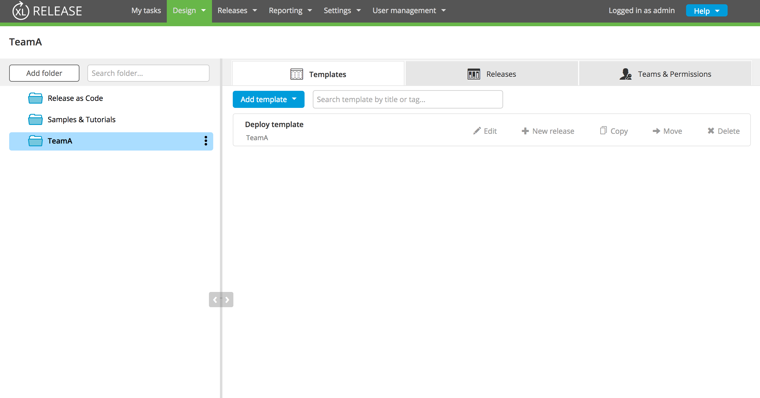
Release Team Folder Updated

Slide 19
Groovy DSL

Slide 20
Scripts Tab In Folder

Slide 21
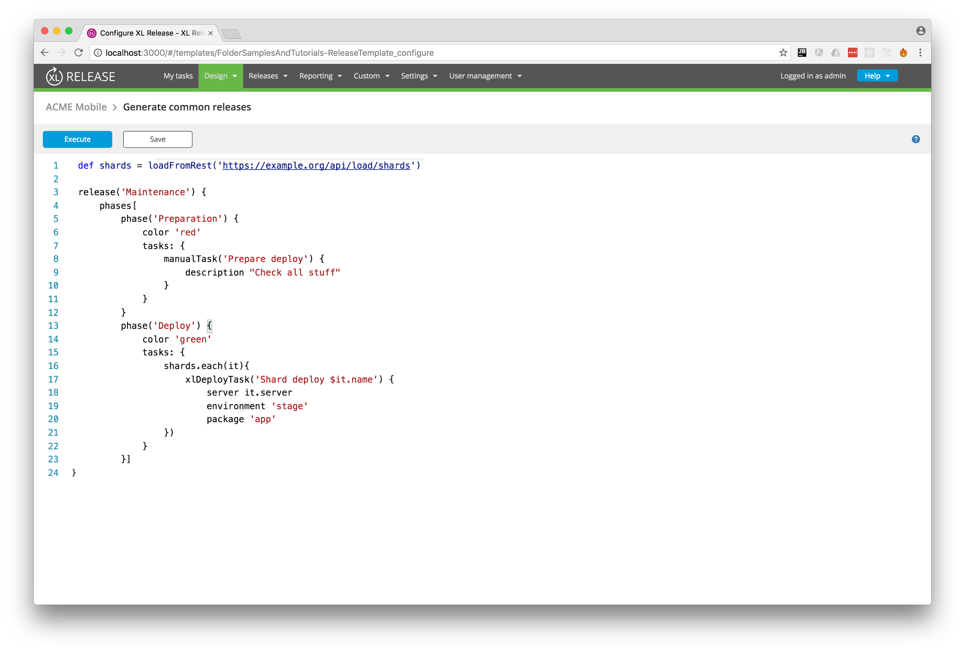
Editor

Slide 22
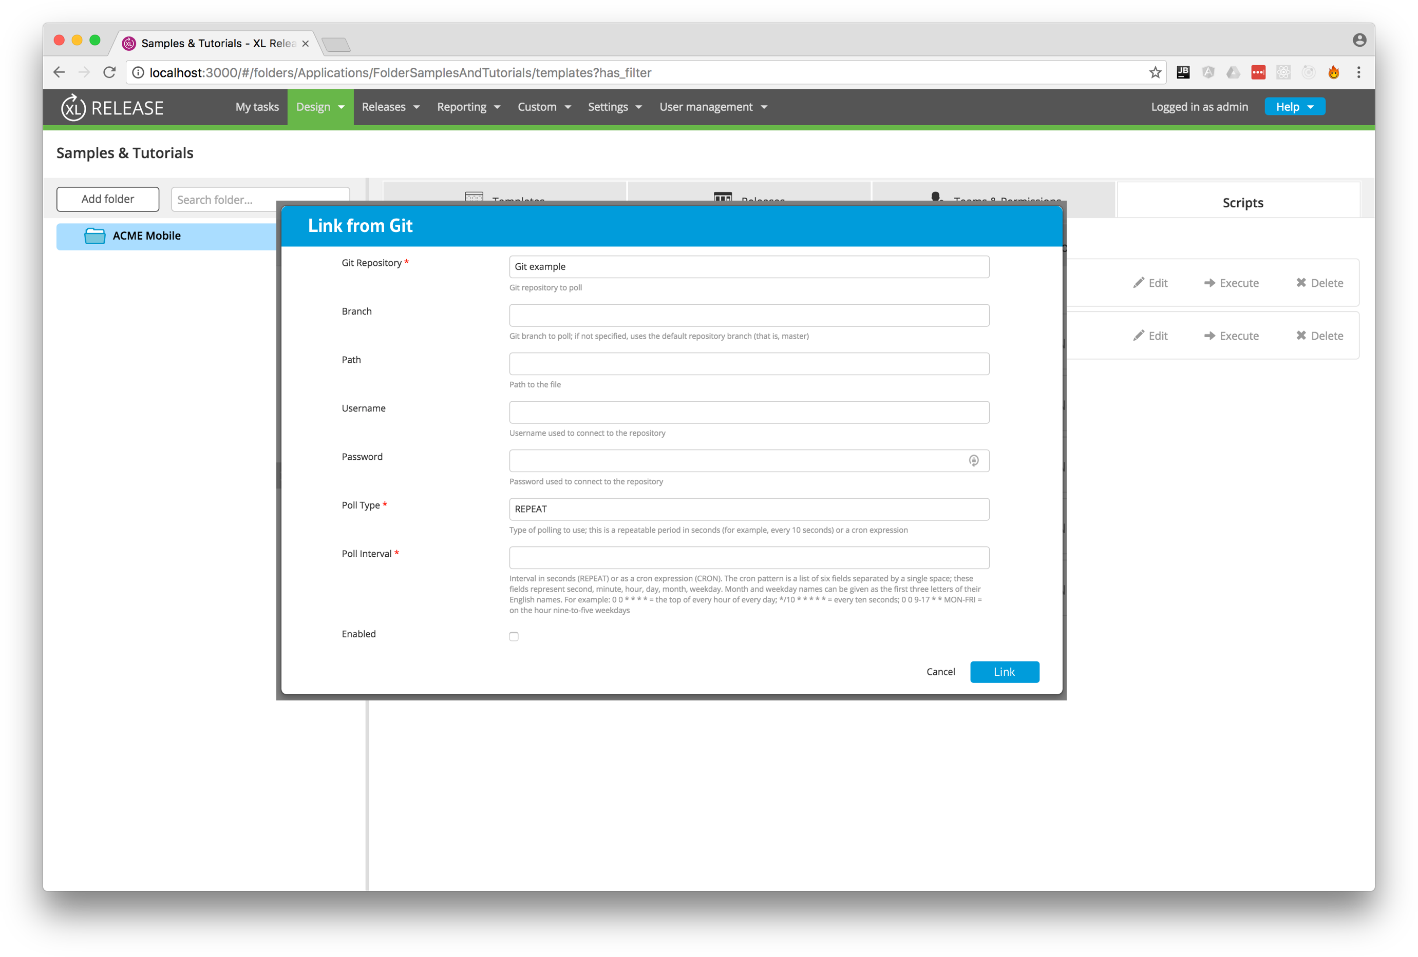
Link to SCM

Slide 23
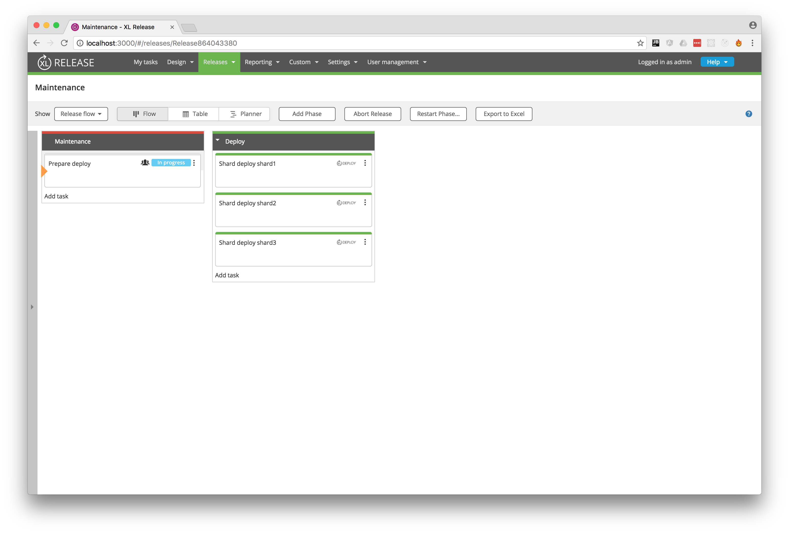
Results of DSL Execution

Slide 24
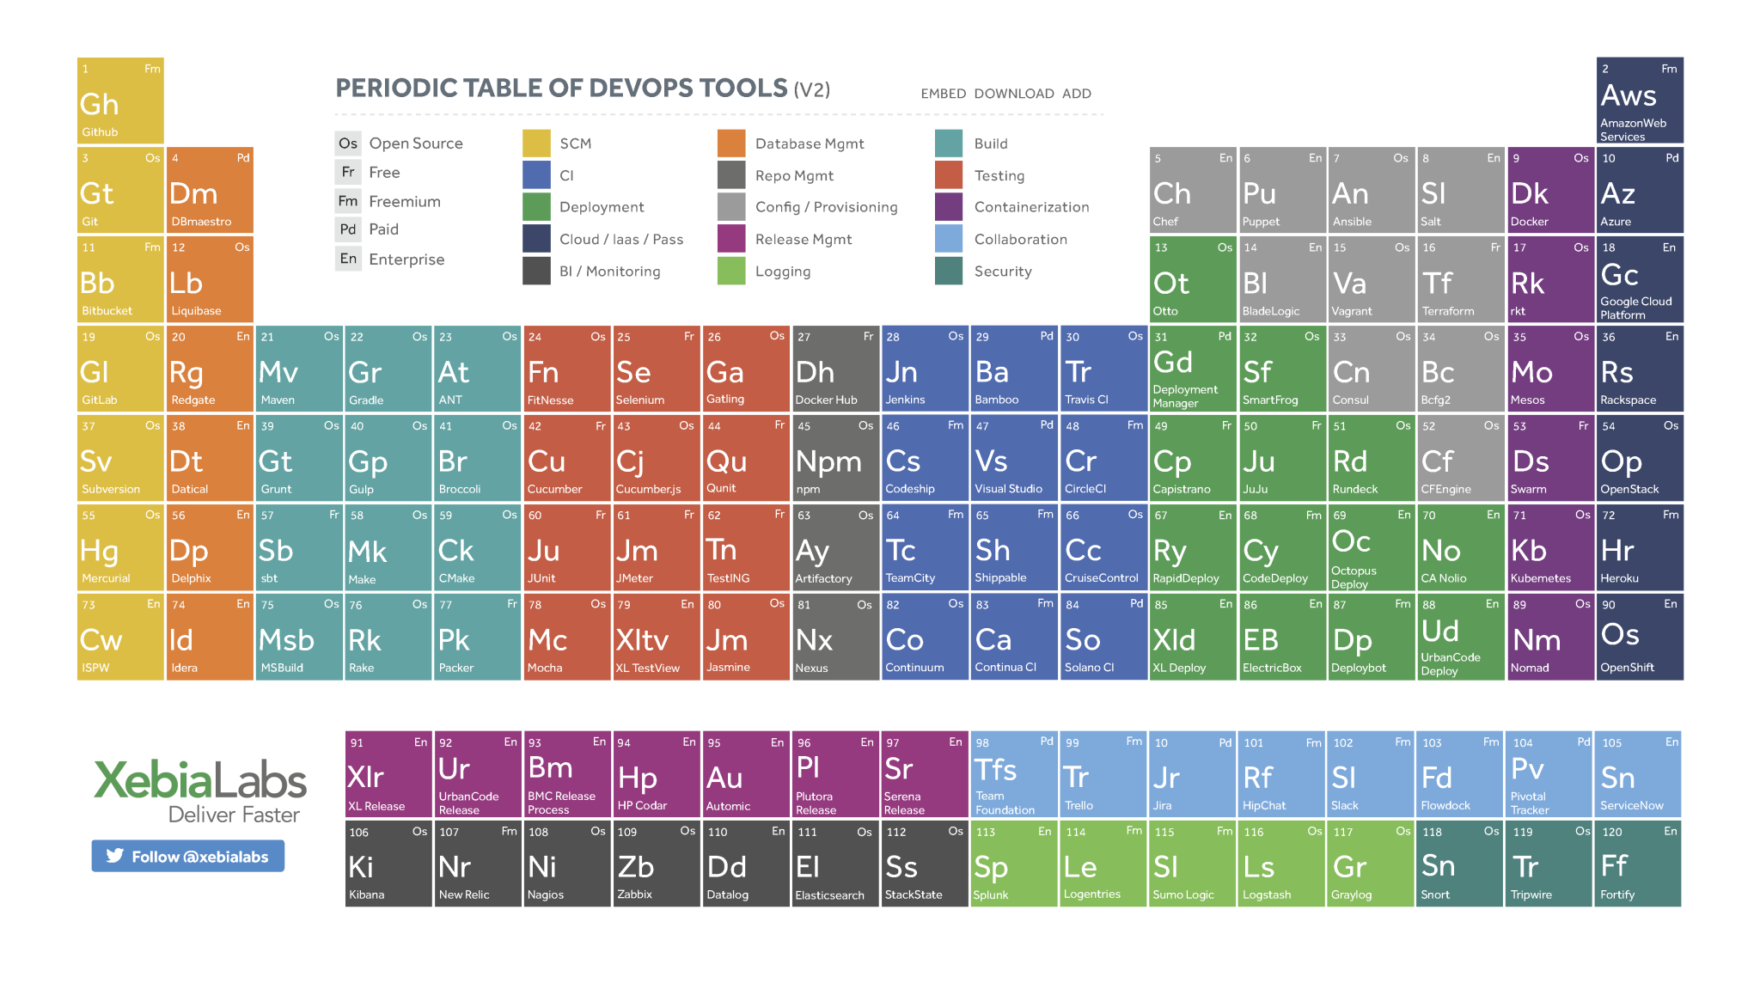
Questions

